Slide 1





Riwu Julian Ruomu Shaun

Slide 2
7
How many things can your mind hold in working memory?

Slide 3

Labour Day on
1 May
Meet Juliet tomorrow at 3pm
Submit sales report to boss by Fri
John’s wedding 15 May 8-10am
Gym session every 2 days 7-9pm
Safety briefing every Monday
Read War and Peace

Slide 4
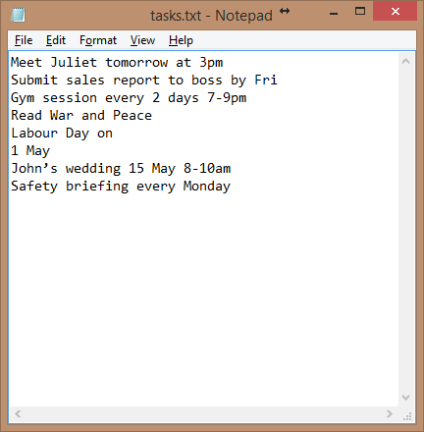

Slide 5
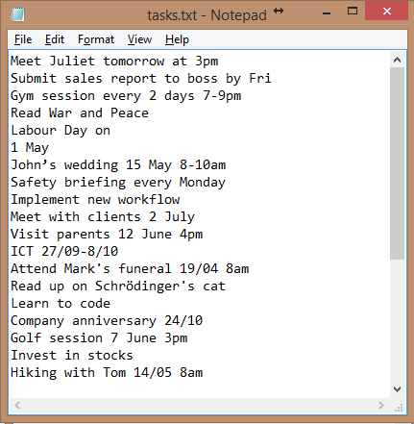

Slide 6
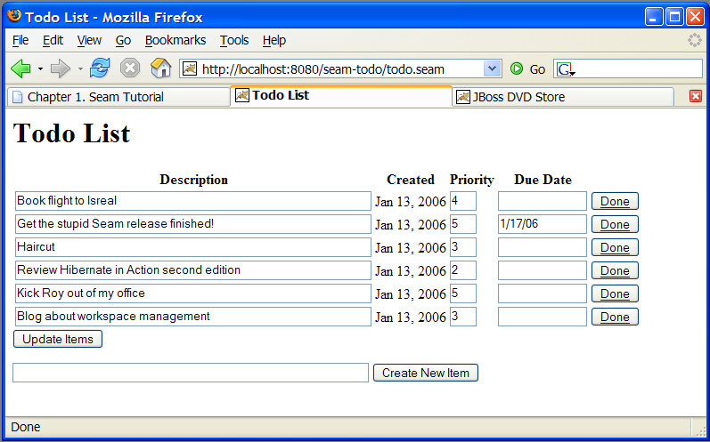
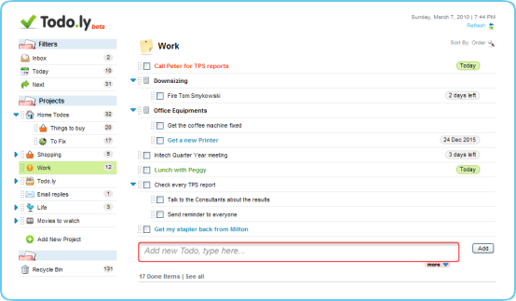
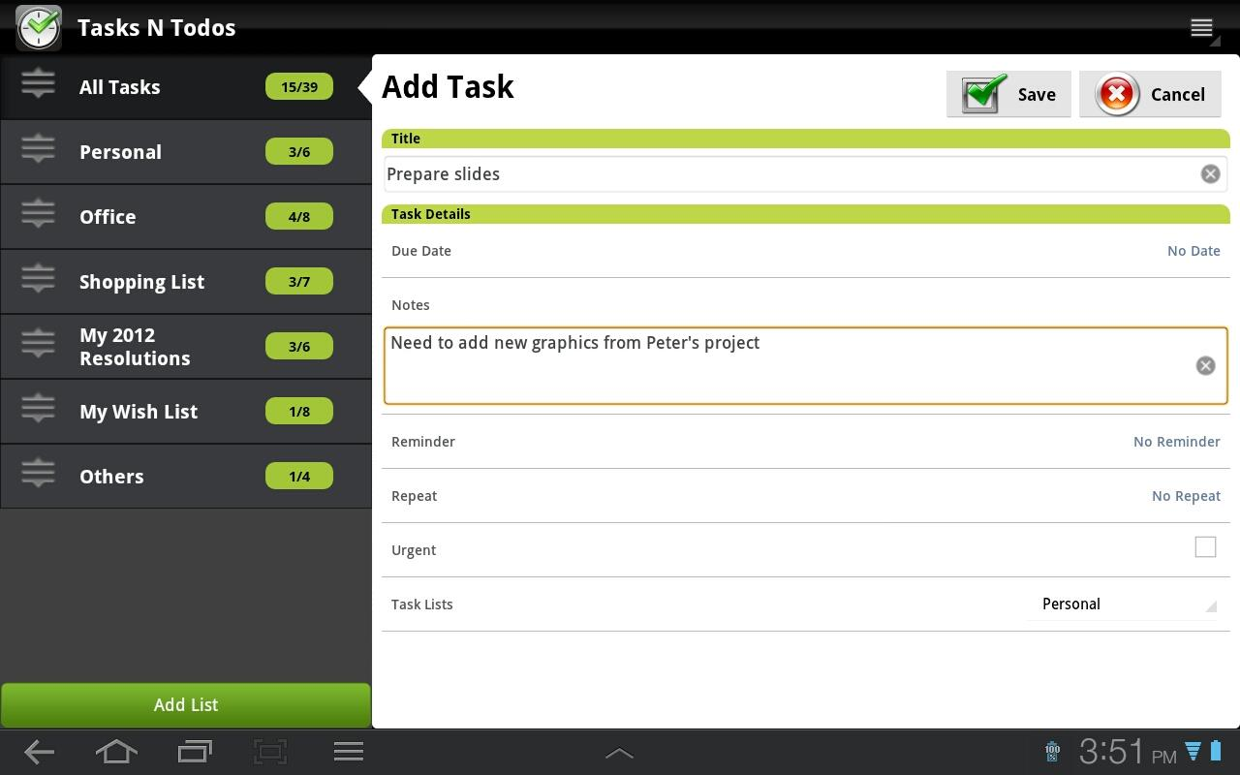
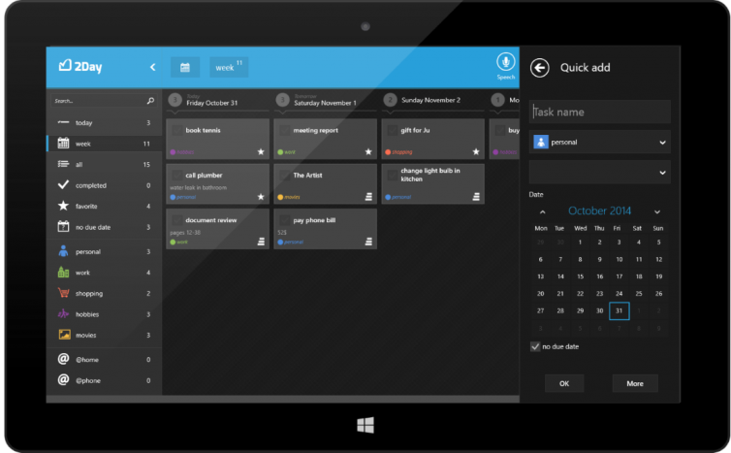
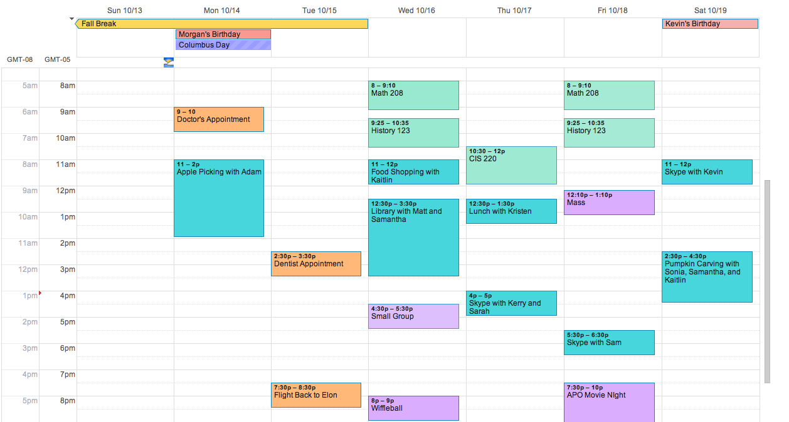

Slide 8
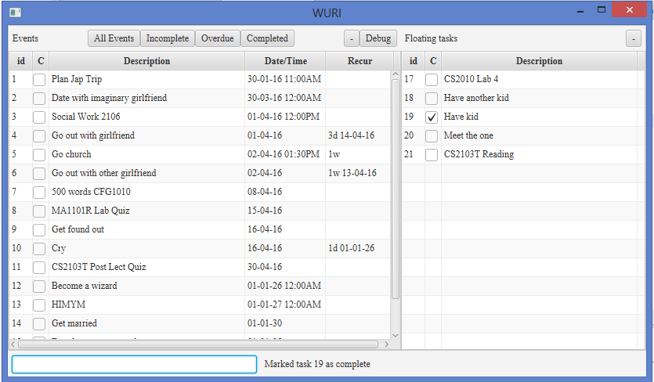
Notes:
Label components

Slide 9
Free and Open source
Safe and Virus-free
Continuously developed; never obsolete
Customisable by any programmer

Slide 10
Run on anything with Java
Download for free at www.java.com
Windows, Linux, Mac

Slide 11
Reliable
Task list saved to file after every operation.
Stable and never crashes

Slide 12
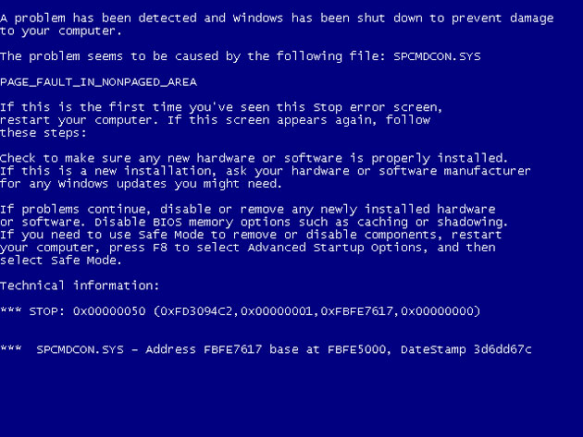

Slide 13
Performance
Saving done only after list updated on display
No perceivable delay

Slide 14
Ease of use
Only need keyboard
Minimal keywords
Single letter commands

Slide 15
Adding and Editing
Simple
Minimal effort
Notes:
Thank you Riwu and good afternoon everyone. I am Julian, and I will be bringing all of you through the add and edit capabilities of WURI. First off, WURI’s add feature is amazingly simple, built with the sole purpose of allowing users to add tasks with minimal effort. As showing will definitely bring more clarity than seeing, let us jump right into it!
Now, imagine that you want to read some books in your free time, at your own pace. You can simply type “Read books” into WURI for it to be recorded down for you!
Now, lets just say that you are meeting a friend for lunch on this Saturday. Simply type “Meet friend Saturday 12pm” to record it down into WURI.
Tada, isn’t it amazing?
Moving on, how many of us here have work due by the end of almost every week?
For me I often have work due by the midnight of Sunday. If you face a similar situation, no problem! Just type “Do work Sunday 23:59 1w” and WURI will now record this task every week on Sunday. If Sunday has passed and you want to move the deadline to the next weekend, simply type “d 1” to delete last Sunday’s task, bringing forth to the next week. I will leave Ruomu to discuss the rest of deletion later.
Now imagine if your meeting with your friend got rescheduled to Thursday instead. Simply type “e 1 thurs” and the date will be edited accordingly. Now what if your friend suddenly says that he can only make it for dinner as it is a weekday? Fret not! Type “e 1 7pm” and the new time will be reflected in WURI.
Lastly, imagine that your workload has increased and that you now have work due every 3 days! We totally understand that at this point, you do not have the time to fiddle around with fanciful commands, so we’ve kept it short and sweet. Simply type “e 2 3d” for your deadlines to now be set every 3 days! I will now be passing the time over to Ruomu to talk about the rest of WURI’s capabilities.

Slide 16
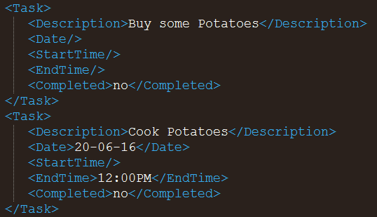
Storage
Extensible Markup Language (XML)
Simple structure
Easy to edit

Slide 17



Storage

Slide 18

What’s next?
Colour scheme
Change Fonts
Mobile App
Notifications
Modular
Encryption
Web App
Scalable
Autocomplete
More

Slide 19

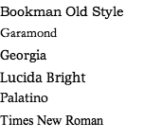
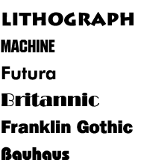
What’s next?
Customizability
Colour scheme
Font

Slide 20

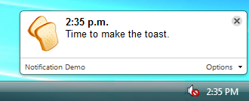




What’s next?
Notifications
Encryption

Slide 21
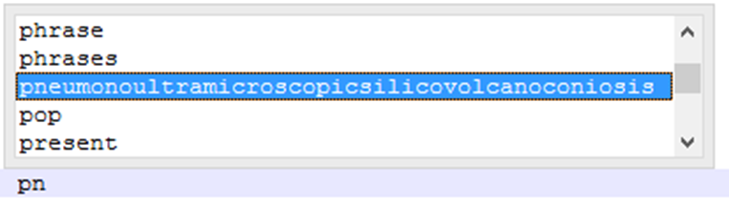
What’s next?
Autocomplete & Autocorrect
Personalized

Slide 22
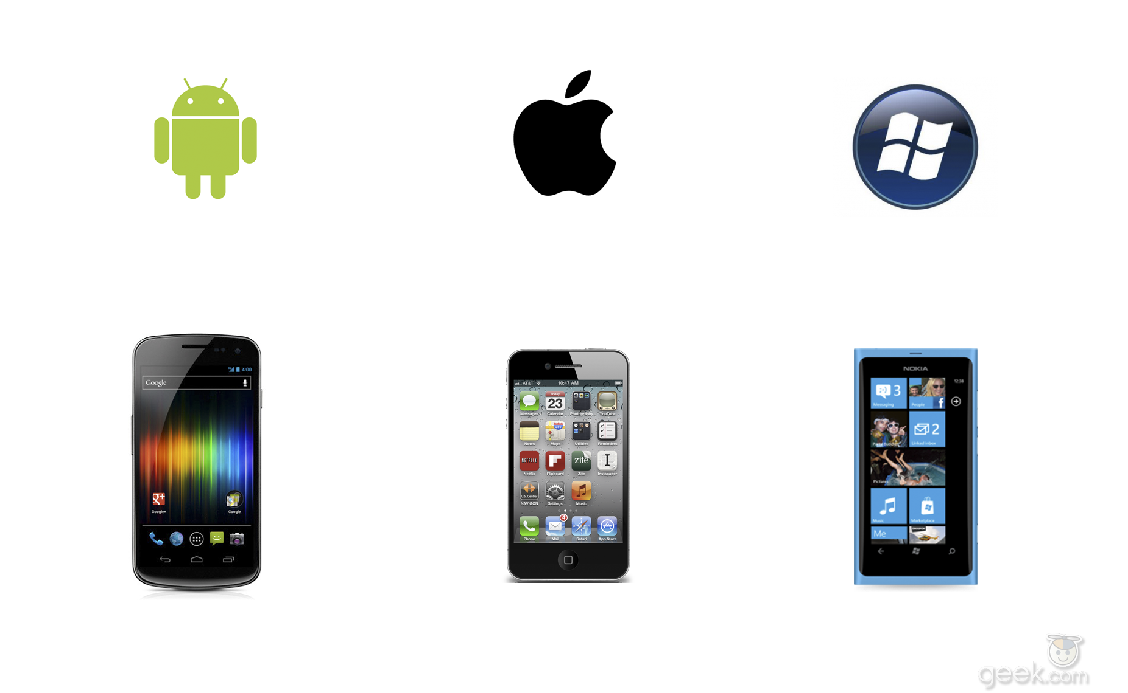

What’s next?
Mobile support
Web Application

Slide 23
Questions?

